Slide 1

PYEONGTAEK
VALID THROUGH 30 NOV 2023

Slide 2

Cancellation Policy
Tour must be cancelled 7 business days prior to the date of the trip to avoid penalty.
100% penalty of quoted price will be charged when cancelled the same day the trip.
70% penalty of quoted price will be charged when cancelled the day before the trip.
50% penalty of quoted price will be charged when cancelled 2 days before the trip.
30% penalty of quoted price will be charged when cancelled 3 days before the trip.
20% penalty of quoted price will be charged when cancelled 4-6 days before the trip.
Understanding the Port Guide
1. Listed price for each trip can accommodate up to 43 passengers on all trips, except DMZ Trip. DMZ Trip is set to accommodate up to 40 passengers, regardless of the number of actual sign-ups. No partial payment adjustments allowed for less than max number of passengers.
2. Payment will be made to Navy MWR Korea. MWR pays everything upfront to the tour company. Ship must provide tour dates, number of buses needed and number of passengers
for each tour 5-7 days prior to arrival, for reservation of buses/ tour guides.
3. If a check is returned for any reason, an administrative fee will be added to the invoice.
4. Prices are subject to change by vendor with little or no prior notice.
5. Navy MWR Korea, or any other federal agency, is not responsible for any errors nor do these constitute federal endorsement. Information is only provided to serve as a guide.
6. Every effort is made by MWR to find the best service from the vendors; however,
quality of service cannot be guaranteed.
7. Email Correspondence: MWRChinhaeRecreation@fe.navy.mil
8. Price valid Through 30 NOV 2023

Slide 3
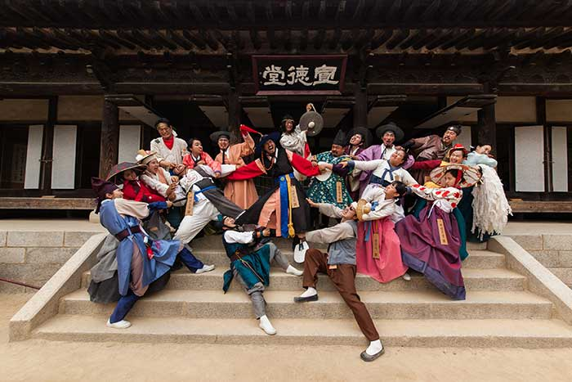

GYEONGGI-DO TRIP
KOREAN FOLK VILLAGE & WAUJEONGSA TEMPLE
Highlights
Korean Folk Village: Offers a blast from the past theme park presents the traditional lifestyle, culture of Korea and Korean traditional music and dance.
Waujeongsa Temple: Situated between 48 mountain peaks, this temple features a massive reclining Buddha statue that is 10 feet high and 32 feet long
Cost
Bus: Estimated Daily Cost of $600
English translator/guide: $180
Entry Fees: $25 per person
Itinerary
Depart pier at 0830
Depart Korean Folk Village at 1500
Return around 1700
Notes
All guests will need to bring Korean Won for lunch & snacks. If guests are staying overnight in the area, notify Guide/Bus Monitor before departure.
Travel Time: Each stop is approximately 10-45 minutes???
Location Details
o https://www.koreanfolk.co.kr/multi/english/
o https://english.visitkorea.or.kr/enu/ATR/SI_EN_3_1_1_1.jsp?cid=264189

Slide 4
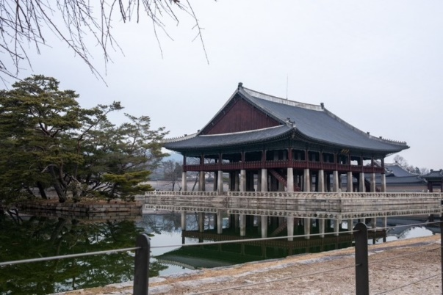

SEOUL TRIP
KOREA WAR MEMORIAL MUSEUM & GYEONGBOKGUNG PALACE & PUKCHON HANOK VILLAGE
Highlights:
War Museum: Offers several display rooms covering the many wars Korea has been involved in and an outdoor exhibition center displaying military Equipment
Gyeongbokgung Palace: The Royal Residence in Joseon Dynasty
Pukchon Hanok Village: Many cultural centers and museums showcase the culture of the Joseon Dynasty.
Cost
Bus: Estimated Daily Cost of $700
English translator/guide: $180
Entry Fees: $2 per person
Itinerary
Depart pier at 0800 and return around 1700.
Travel Time: ~1 hours each way
Notes
Bring Korean Won for lunch and snacks.
Location Details
o https://www.warmemo.or.kr/Eng/index
o http://www.royalpalace.go.kr:8080/html/eng_gbg/main/main.jsp
o https://hanok.seoul.go.kr/front/eng/town/town01.do

Slide 5
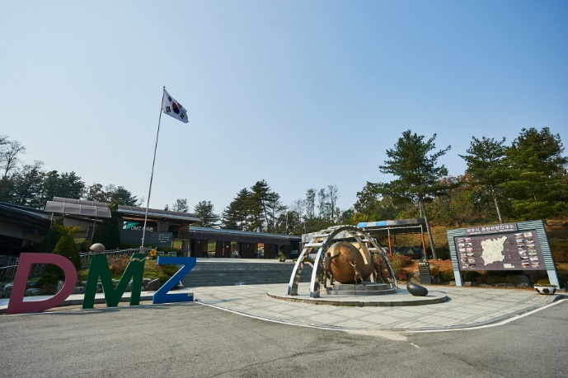
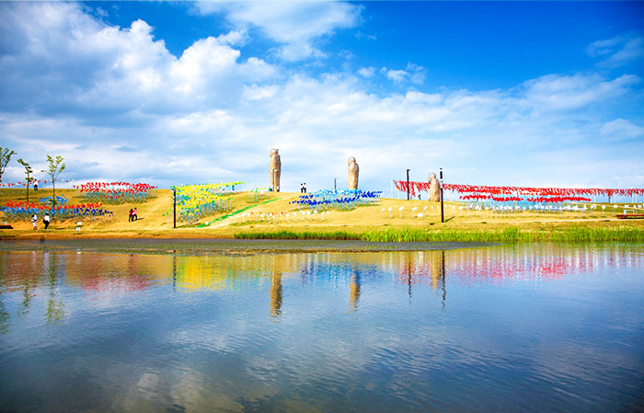
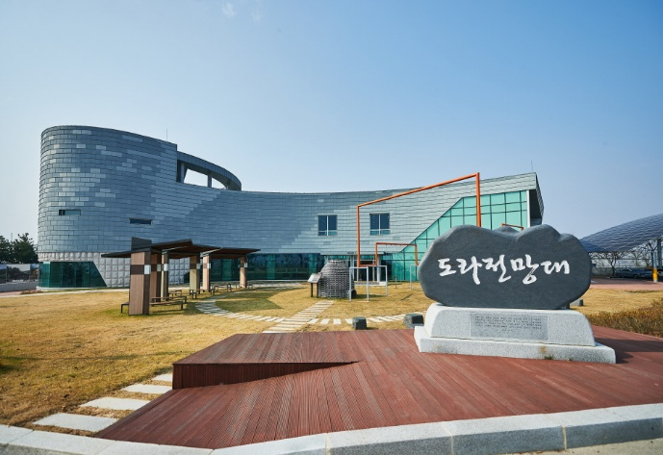
3. IMJINGAK Tours (The 3rd Tunnel & Dorasan Observatory)
Located 7 kilometers from the DMZ, Imjingak is an important part of Korean history. Imjingak Resort has various war-related artifacts as well as spacious Pyeonghwa Nuri Park. The resort preserves the Freedom Bridge and Imjingang rail bridge from the Korean War to remind people of the past, along with a Memorial Hall, memorial monuments, and recreational areas.**Not Available on Mondays
Cost
Bus: Daily cost of $820
English translator/guide: $180
Entrance Fees: $10 per Person
$6 per Person/Group discount for more than 30 people.
Itinerary
Depart pier at 0630
Depart Imjingak at 1500
Return around 1700
Notes
Bring Korean Won for meals, snacks and souvenirs.
Location Details
o https://english.visitkorea.or.kr/enu/ATR/SI_EN_3_1_1_1.jsp?cid=264487
o https://english.visitkorea.or.kr/enu/ATR/SI_EN_3_1_1_1.jsp?cid=264488

Slide 6
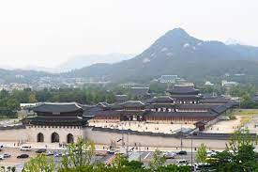
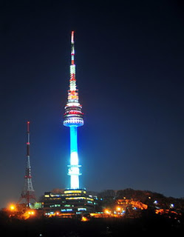

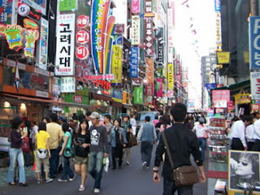
4. Seoul Tours (overnight tours can be booked on request)
--National Museum of Korea: Available 10 people entrance at a time
Cost
Bus: Estimated Daily Cost of $1100
English translator/guide: $350
Entrance Fees: Range from $3 - $25 based on customer requests.
Itinerary
Bus departure and return based on request.
Travel Time: ~2 hours one way
Notes
Bring Korean Won for meals, snacks and souvenirs.
Location Details
o http://www.visitseoul.net/en/index.do
o http://english.visitkorea.or.kr/enu/index.kto
Gyeongbok Palace
Closed Tues.
Changdeokung Palace
Closed Mon.
OR
National Museum of Korea
Myeongdong Shopping
Seoul Tower

Slide 7

5. Seoul – Room Reservation
Navy MWR Korea assists in making individual and group reservations at Dragon Hill Lodge with special room rates!
Cost
Room rates as noted below. Maximum of two people per room recommended.
E1-E6: $80.00
E7-E9/WO1-CW3/O1-O3 : $94.00
CW4-CW5/O4-O10/CIVILIAN: $108.00
Itinerary
Bus departure and return times can be arranged based on request.
Notes
Travel Time: ~2 hours one way
Bring Korean Won for meals, snacks and souvenirs.
Dragon Hill Lodge accepts U.S. Dollars
110v electricity and has a small exchange on property
Check below website for details and room amenities.
Location Details
http://www.dragonhilllodge.com/
https://yongsan.armymwr.com/

Slide 8
6. Wi-Fi
Connect with family, download your favorite shows with Korea’s 5G Wi-Fi.
Speak with an MWR Representative about its options.
Rates:
In Korea rental fee is based on day-by-day, not 24-hour basis.
Ex: If you pick up at 23:59 and return it at 01:01= total 2 days.
Individual rentals (Pucks and SIM card) at Pier Vendor
SIM Card: $6.00 (1-day), $15 (3-days), $23 (5-days)
Wi-Fi Puck (connect up to 3 devices): $4.00 (1-day)
  $100 Wi-Fi puck deposit is automatically charged with payment.
Group rental: Pick-up & Return Service (pucks only)
Wi-Fi Puck (connect up to 3 devices): $4.50 (1-day) per device
  No deposit hold; however POC will be charged $100.00 for each Wi-Fi Puck not returned.
Location Details:
Work with MWR on drop off, pier sales, and dates/times for return

Slide 9
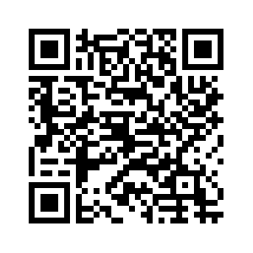
7. What to know about Korea
Scan the QR code to view the following:
Do-It-Yourself (DIY) Local Guides
Taxi guides
Busan Subway +Intercity Bus Guide
Busan Metro Subway Map
Busan City Map
- SOFA Statement
Common Korea Apps
Common Korean phrases
NavyMWRKorea.com/Explore

Slide 10
12. Port Brief Information
Taxi
  Taxi’s are very cheap in Korea.
  99% of taxi’s take credit card.
  Uber doesn’t exist in Korea. Download “Kakao T” to call taxi’s and pay the driver when you arrive at destination.
Navigation
  Google Maps doesn’t exist in Korea. Download “Naver Maps” for directions to anywhere you want to go.

